Slide 1

Project Proposal
by Sadman Sakib Khan Promit

Slide 2

Surveillance using Natural Language Processing
Motivation
The system will be able to eavesdrop and classify
Emotions

Slide 3

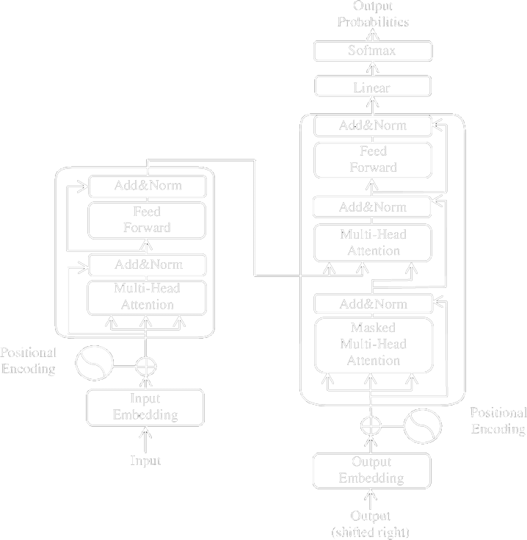
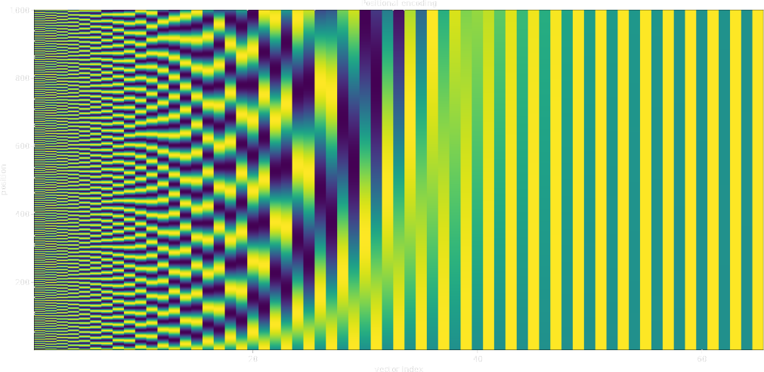
Surveillance using Natural Language Processing
Algorithm
Transformer

Slide 4

Requirements
Speech Recognition Datasets available at Kaggle
Common Voice (13 GB)
AccentDB - Core & Extended (7 GB)
Speech Recognition Dataset (4 GB)
fluent-speech-corpus (2 GB)
speech-recognition-16000sr (2 GB)

Slide 5
Requirements
Speech Datasets available at Kaggle
RAVDESS Emotional speech video (13 GB)
Multimodal EmotionLines Dataset(MELD) (12 GB)
NOR Smart Speech (2 GB)
ASVP-ESD(Speech & Non-Speech Emotional Sound) (2 GB)
Audio emotions (1 GB)
Audio Emotion Dataset (1 GB)

